Slide 1
Reconfigurable Computing 2
Introduction to SYCL
Greg Stitt
Associate Professor
Department of Electrical and Computer Engineering
University of Florida

Slide 2
Heterogeneous Computing
Different devices are specialized for different workloads
E.g. GPUs are optimized for data-parallel computing
Heterogeneous computing systems can delegate tasks to hardware specialized for each task
CPUs, GPUs, FPGAs, ASICs, etc.

Slide 3
Heterogeneous Computing Problems
Specialized languages are often required for different devices and vendors
Writing custom-tailored code for accelerators is not flexible or distributable
Code cannot be shared or re-used with other devices
Code may need to be entirely re-written if changing devices
New accelerator technologies are emerging for AI, etc.

Slide 4
Heterogeneous Programming
High-level languages allows for one code base to be run on a variety of devices
The same code can be re-used on different devices
Code can be more easily tweaked for different applications
Libraries contain pre-written code custom-made for each architecture
Every high-level function call is optimized for each supported device
Performance theoretically equivalent to writing lower-level code manually
Much faster to write than lower-level code, especially RTL
OpenCL is the current standard
SYCL also exists

Slide 5
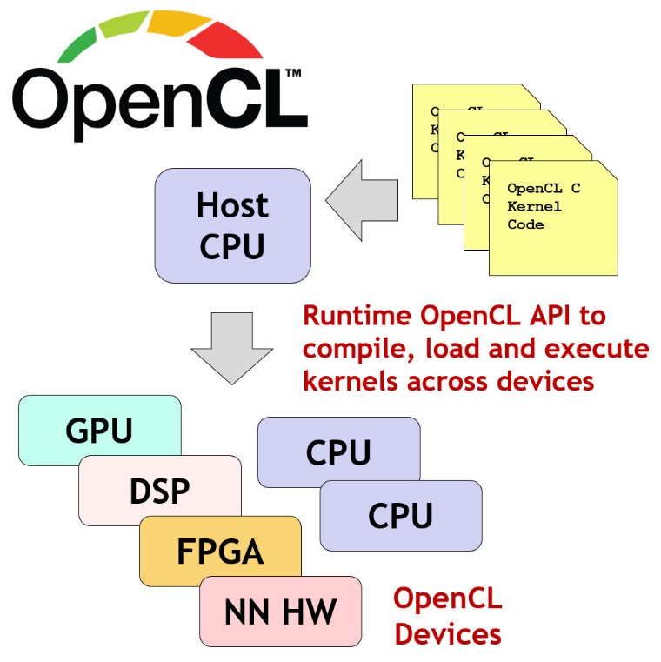
OpenCL
A cross-platform programming framework for heterogeneous parallel computing
Abstracts lower-level hardware functions
Allows the same code to be used across different devices and vendors
Gives the ability to utilize different accelerators without use of vendor-specific languages
Provides models for memory and execution
Abstracts memory operations and code execution
5

Slide 6
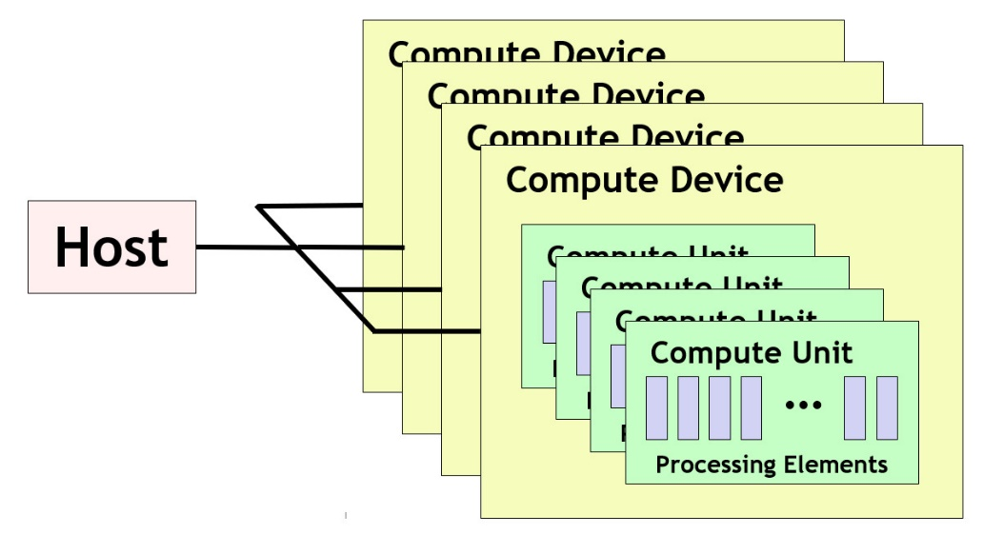
OpenCL Architecture
OpenCL standard defines a single Host which controls multiple Compute Devices
CPUs, GPUs, FPGAs, etc.
Each Compute Device consists of one or more Compute Units
Such as cores in a CPU
Each Compute Unit consists of multiple Processing Elements
Components such as ALUs, on which work items are scheduled to run
A compute device may be a GPU. Its compute units would be the streaming multiprocessors inside the GPU. The streaming multiprocessors are themselves comprised of individual streaming processors, which serve as processing elements.
6

Slide 7
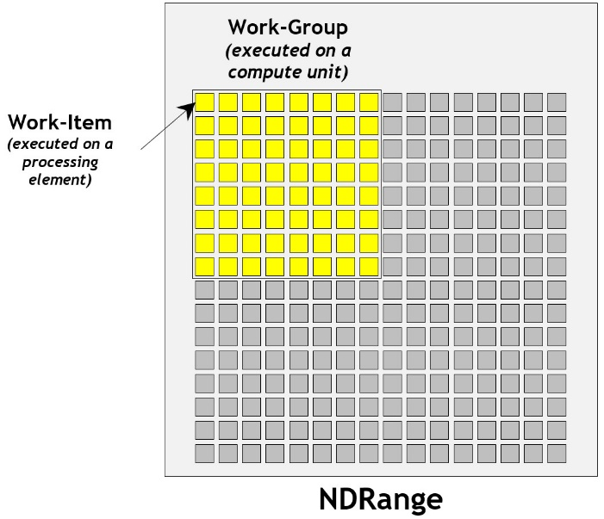
OpenCL Execution Model
The Host uses OpenCL API to manage and interface with Compute Devices
CPUs, GPUs, FPGAs
Work is submitted to the Processing Elements in the form of “Kernels”
Written in an extension of C99, called OpenCL C
C++ for OpenCL, a C++17-based language, can also be used
After submission, Kernels will execute in parallel with the host process
Each item of execution is referred to as a “work-item” (CUDA threads)
Work-items are grouped together to form “work-groups” (thread blocks)
7

Slide 8
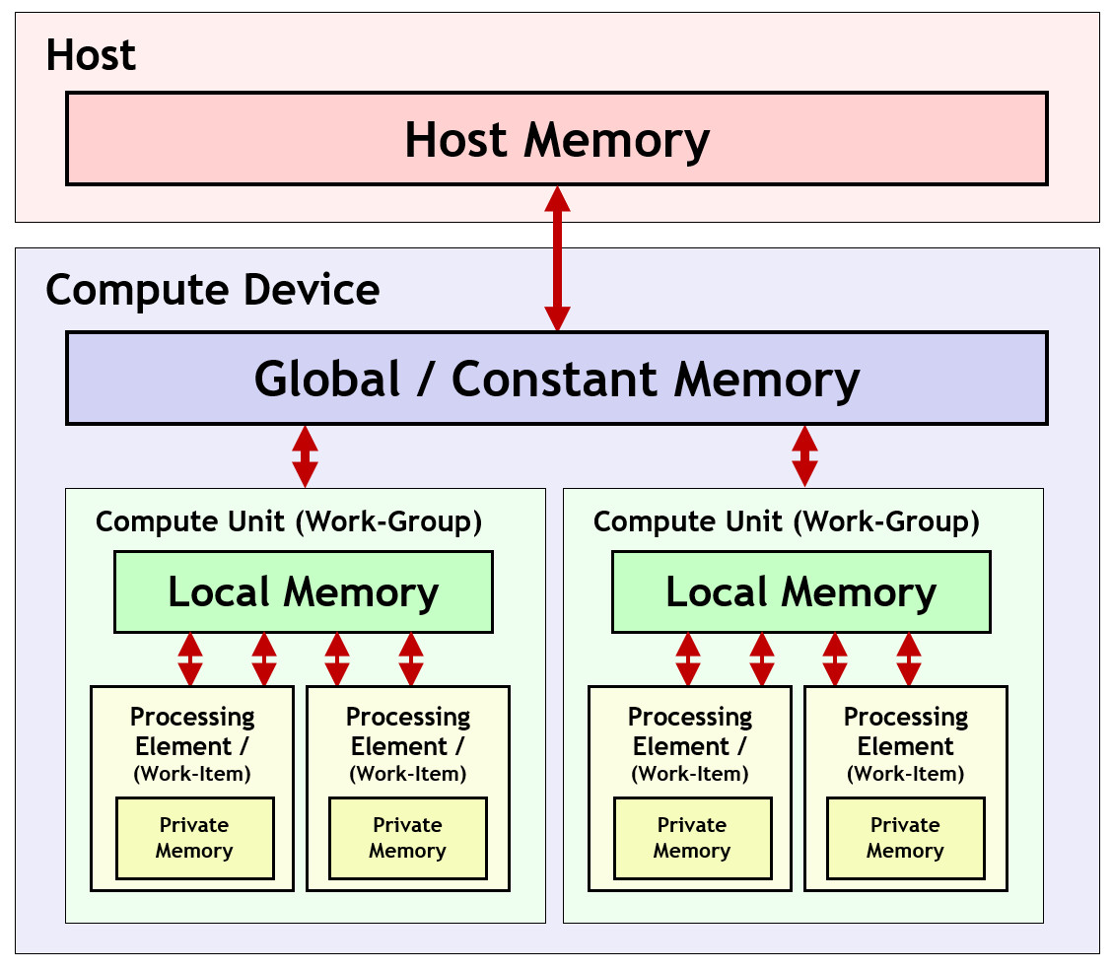
OpenCL Memory Model
The OpenCL memory model defines a hierarchy of memory types:
Host Memory
Available only to the host CPU
Global/Constant Memory
Available to all compute units in a compute device
Local Memory
Available to all processing elements in a compute device
Private Memory
Available to a single processing element
8

Slide 9
OpenCL Execution Sequence
A complete sequence for executing an OpenCL program is:
Query for available OpenCL platforms and devices
Create a context for one or more OpenCL devices in a platform
Create and build programs for OpenCL devices in the context
Select kernels to execute from the programs
Create memory objects for kernels to operate on
Create command queues to execute commands on an OpenCL device
Enqueue data transfer commands into the memory objects, if needed
Enqueue kernels into the command queue for execution
Enqueue commands to transfer data back to the host, if needed
9

Slide 10
SYCL
An abstraction layer that builds upon OpenCL
Utilizes the same memory and execution models
Higher-level than OpenCL but has seamless integration with OpenCL and C++ libraries
Able to be used on a wider range of platforms
Can target other APIs besides OpenCL
Single source code
Code does not need to be separated between host and device code

Slide 11
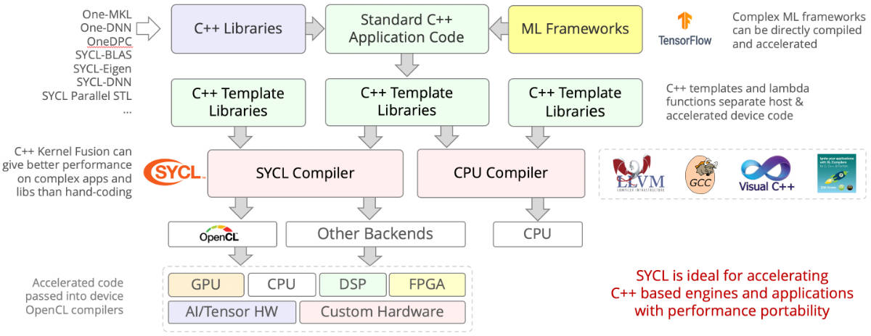
SYCL Flowchart

Slide 12
Basic SYCL Program
In any SYCL program, the host must:
Choose an accelerator device
Device is chosen with the ”device selector” class
Accelerator support is determined by the compiler
Intel’s DPC++ compiler natively supports Intel GPUs via OpenCL
Intel FPGAs are supported through their SYCL extension
Default selectors will choose the most capable device at runtime
gpu_selector, cpu_selector, accelerator_selector, fpga_selector
Alternatively, we can extend the device selector class for custom selection criteria
Tell the device what to do
Transfer data between host and device

Slide 13
Basic SYCL Program
Host chooses from available accelerator devices using ‘device_selector’ class
FPGA
Host
GPU
AI

Slide 14
Basic SYCL Program
Host sends instructions to and receives feedback
from device using ‘queue’ class
Queue
Host
Kernel instructions
GPU
Device feedback

Slide 15
Basic SYCL Program
References to host memory are contained in the ‘buffer’ class
Memory referenced by buffers is written/read using ‘accessor’ class
Queue
Host
GPU
Host
GPU
Buffer
Accessor
Data
Data
Data
Data
Data
Memory
Data
Memory

Slide 16
Device Selection
Default selector chooses most capable device at runtime
Device selector classes exist to choose from specific class of device
gpu_selector
cpu_selector
accelerator_selector
fpga_selector exists via intel extension
Useful for quick development, but typically want specific device for a task
Custom selectors created by extending device_selector base class
virtual int operator()(const device &dev) const {
/* Device selection logic */
}

Slide 17
Custom Device Selection
operator() is key to device selection
Runs on each available device
Returns an integer score for each device
Device which returns highest score is selected
Devices which return negative scores will never be selected
User is free to define any logic for scoring
Allows for arbitrarily complex device selection logic
In simple cases, selecting based on device name or vendor is sufficient

Slide 18
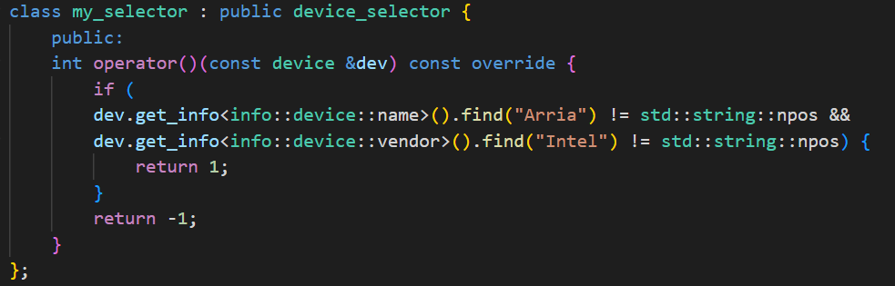
Custom Device Selection Example
Source: Data Parallel C++, James Reinders et al. pg. 46

Slide 19
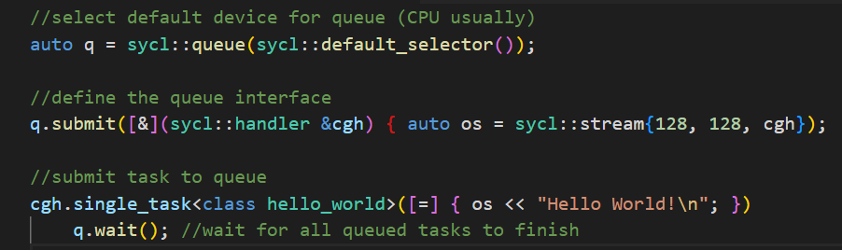
Queues
Abstractions used for submitting work to a device
Bound to a single device upon creation
Device is selected via device_selector class
Can allow selector to select from a class of devices or write custom selector
Tasks submitted to queue are offloaded to device when conditions are met
Host continues execution of the program after submission to the queue
Task execution can be in-order or out-of-order
Out-of-order by default, execution order determined by runtime
Can be instantiated with the in-order property for implicit dependency specification

Slide 20
Buffers
Data abstractions of a certain C++ type
Can be scalar data types, vectors, or other user-defined class/structure
Must not require the use of copy constructors for copying
Represent data objects, not memory addresses
Cannot be accessed like C++ arrays
Accessors must be used to read from and write to buffers
A single buffer may be distributed across multiple locations
Between discrete memory locations and devices
An empty buffer may be created by specifying a range for size
Data must later be initialized before the buffer can be read from
Existing host data may be used to initialize a new buffer
Accomplished by invoking a constructor that takes a pointer to an existing host allocation
May also be created from existing cl_mem objects if using OpenCL compatibility

Slide 21
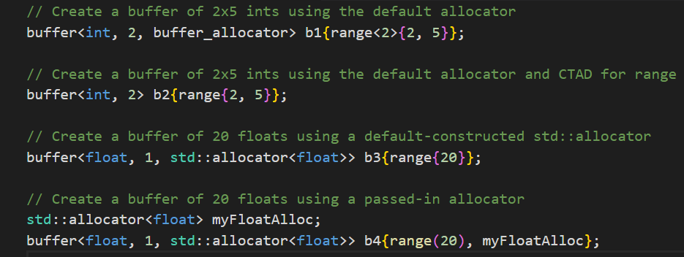
Buffers Examples

Slide 22
Accessors
The only way in which to read from or write to buffers
Can be instantiated with read, write, or read_write access modes
Accessors are read_write by default
Using appropriate access modes is important
Provides implicit information used to help the runtime manage memory
For example: read mode tells the runtime that it does not need to copy memory back to the host, as the device has not changed it.
Appropriate use of access modes will help the runtime optimize kernel scheduling and data migration

Slide 23
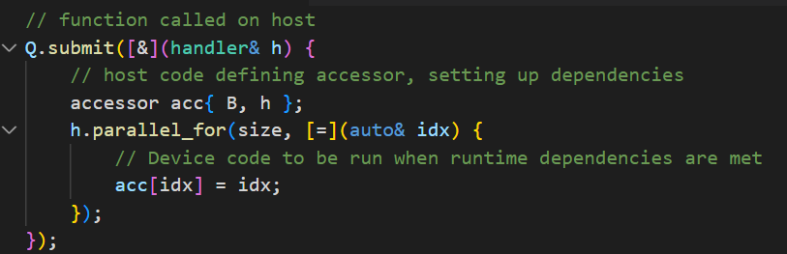
Accessors Example
Source: Data Parallel C++, James Reinders et al. pg. 27

Slide 24
Example
vector_addition.cpp
https://github.com/BenjaminMFindley/Reconfig-2-SYCL-DPCPP/blob/main/Examples/vector_addition/vector_addition.cpp

Slide 25
Data Management
Running heterogeneous computing systems efficiently requires careful handling of data
Data must be available for accelerator execution as promptly as possible as any idle time is wasted
There are two methods for managing data in DPC++
Unified Shared Memory (USM)
Buffers
Device code requires data as input and may output its own data
Devices may have their own distinct memory which cannot be accessed by the host
Proper data management deals with the safe and efficient storage and movement of data between memory pools
Remote Accesses are accesses to data in another device’s memory
Very slow
Local Accesses are accesses to data in directly-attached memory
Much faster than remote accesses
It is desirable for a device to utilize local memory for computation
May require manual movement of data between memory pools to ensure data is in local scope

Slide 26
Dependency
Dependencies between tasks may be implicit or explicit
Explicit dependency refers to dependency between computations
Most relevant to code utilizing USM for data management
Dependencies specified using events
Implicit dependency refers to dependency between data accesses
Relevant to code utilizing buffers for data management
Dependencies specified through accessors

Slide 27
Implicit vs Explicit Memory Management
Memory Management can be either implicit or explicit
Explicitly copied within the program itself
Implicitly copied by the runtime
Implicit Memory Management
Handled automatically by the runtime
Simple and safe
Often at the cost of potential performance
Explicit Memory Management
Defined manually by the programmer
May be optimized for better performance
For example: transfer data while device is busy with execution
Time consuming and error prone
Should be reserved for the most performance-critical areas

Slide 28
Data Dependency (Implicit)
Different tasks may depend on one another’s data
Data dependency exists in one of three forms
Read-after-write: Task B must wait for Task A to read before it can write
Write-after-read: Task B must wait for Task A to write before it can read
Write-after-write: Task B must wait for Task A to write before it can write
These relationships are specified implicitly via
Accessor access modes
Task ordering
If two accessors exist for the same data, whichever task is submitted first will be executed first
An implicit dependency is created based on the types of access

Slide 29
Computational Dependency (Explicit)
A queue’s submit() function returns an event
Event objects can be captured and referenced for other purposes
wait()
depends_on()
depends_on() is a handler function used to specify dependency
Specifies events on which the current operation depends
Takes an event or vector of events as parameters
Will wait until all specified events have finished before continuing execution

Slide 30
Universal Shared Memory (USM)
Pointer-based memory management system, similar to C/C++ malloc() or new
Defines a unified virtual memory space shared between host and devices
A pointer is valid both on the host and any devices, so no translation is necessary
Defines three types of allocation
Device
Explicit, accomplished via memcpy() function as part of the queue and handler classes
Located on device-attached memory
Only accessible via device. Data must be copied explicitly to move between host and device
Host
Implicit
Accessible via both host and device
Data accessed on host memory by devices does not transfer into local device memory
Sent via bus such as PCI-E
Shared
Implicit
Accessible via both host and device
Can migrate between host and device, allowing for faster execution on device. Occurs automatically via runtime
All allocations are performed by the host

Slide 31
Example
vector_addition_usm.cpp
https://github.com/BenjaminMFindley/Reconfig-2-SYCL-DPCPP/blob/main/Examples/vector_addition/vector_addition_usm.cpp

Slide 32
Example
vector_addition_with_timing.cpp
https://github.com/BenjaminMFindley/Reconfig-2-SYCL-DPCPP/blob/main/Examples/vector_addition/vector_addition_with_timing.cpp

